Slide 1
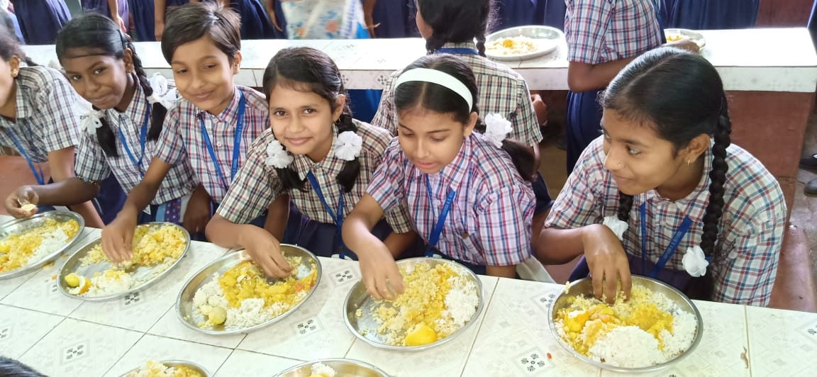
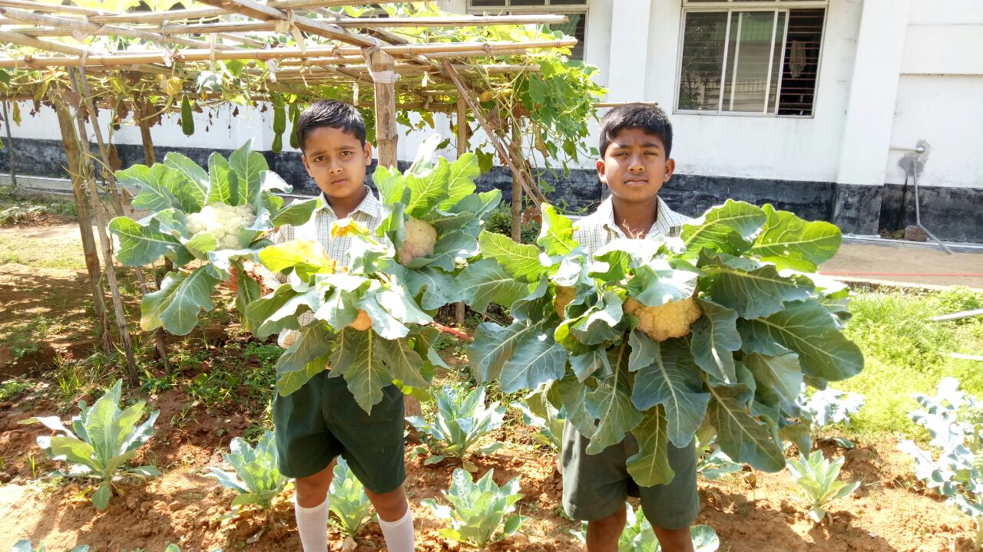
Mid-Day-Meal SCHEME
In Tripura
Meeting of the Programme Approval Board : 2020-21
Date – 05.05.2020

Slide 2
Category of Educational Institutions
Coverage
Stage: Primary (I –V)
Independent Primary Schools (classes I – V)
Primary Sections attached to SB Schools (I-V of SB Schools)
Primary Sections attached to High Schools (I-V of High School)
Primary Sections attached to H.S. Schools (I-V of H.S School)
Stage: Upper Primary (VI-VIII)
Upper Primary Sections Senior Basic Schools (VI-VIII)
Upper Primary Sections attached to High Schools(VI-VIII)
Upper Primary Sections attached to H.S. Schools.(VI-VIII)
100% coverage of all Govt. , aided schools and Madrassas.

Slide 3
1. Details of School Units
Stage | Govt. | Govt. Aided | Madrassa | Total
Primary | 4193 | 34 | 169 | 4396
Upp. Primary | 2083 | 32 | 13 | 2128
Total | 6281 | 66 | 182 | 6524
*Source MDM-MIS

Slide 4
2. Total Enrolment Vs Availed (01.04.2019 to 31.12.2019)
Stage | No. of Institutions | Total Enrollment | No. of children approved by PAB: 2019-20 | Average no. of children Availed MDM in 2019-20 (up to 31st Dec. 2019) | Percentage of children availed MDM Against Total Enrollment
Primary | 4396 | 2,66,326 | 2,21,055 | 2,07,960 | 78%
Upp. Primary | 2128 | 1,65,953 | 1,35,140 | 1,24,397 | 75%
Total | 6529 | 4,32,279 | 3,56,195 | 3,32,357 | 77%
*Source MDM-MIS

Slide 5
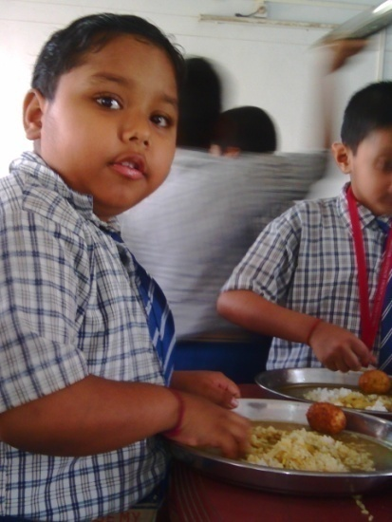
3. Menu & Cost Norms
Weekly Uniform Menu w.e.f. 13th June 2011.
Monday : Khichudi
Tuesday : Rice and Egg curry
Wednesday : Rice & Veg. curry
Thursday : Rice and Egg curry
Friday : Rice & Veg. curry
Saturday : (Payesh /Khichudi /Rice&Veg.)
Cost Norms w.e.f. 1st April, 2020:
A. Primary
Total cost norms: Rs.4.97 per child per day.
Govt. of India’s assistance : Rs. 4.47 & State share:Rs.0.50.
Rice 100 gms.
B. Upper Primary
Total cost norms : Rs. 7.45 per child per day.
Govt. of India’s assistance : Rs. 6.70 & State share: Rs. 0.75.
Rice 150 gms.

Slide 6
Reasons for Uniform common Menu for MDM
Equal and uniform nutritional benefit for all students throughout the state.
Similar Food habits.
Better monitoring and administrative effectiveness.
Quality & quantity of MDM can be checked as per specific fixed menu.
Incorporate locally available vegetables.

Slide 7
4. Cook-cum-Helpers:
At present, 11,011 nos. Cook-cum-Helpers engaged under Mid-Day-Meal Scheme at different school units. Cook-cum-Helpers are getting Rs.1,500/- per month (Central Contribution : Rs.900/- & State Contribution Rs.600/-) as honorarium.
5. Kitchen Shed:
Kitchen Sheds have been constructed in all eligible school units as per guidelines of MHRD.
6. Kitchen Devices:
All school units have been facilitated with kitchen devices up to 2017-18. The fund against replacement of Kitchen Devices for the year 2018-19 & 2019-20 has been received 14.01.2020.

Slide 8
7. MDM-MIS:
100% data entry in MDM-MIS has been completed up-to December, 2019.
8. Implementation of Centralized Kitchen :
As per decision of the Council of Ministers, Government of Tripura, Akshya Patra Foundation and Annamrita Foundation will be introduced for serving of mid-day-meal through Centralized Kitchen in West Tripura District. A MoU has also been signed between the Director, Elementary Education and Annamrita Foundation for setting up semi-automated Centralized Kitchen. Another MOU will be signed shorty with Akshya Patra Foundation.

Slide 9
9. Automated Monitoring System (AMS) :
Automated Monitoring System (AMS) has been rolled out in the State. Presently, average 76% schools are reporting on daily basis. Steps have been taken for covering the 100% schools.
10. Food Testing :
10 (ten) Cooked Food Sample was collected by the Chief Medical Officers of different Districts during the year of 2019-20. All reports are found “No Pathogenic organism grown in culture”.
11. Social Audit:
Social Audit has been conducted in 208 schools under Dukli Block, West Tripura District and Dumburnagar Block, Dhalai District as per guidelines of the Ministry of HRD.
12. Distribution of IFA & De-Worming Tablets:
All school have been provided IFA Tablets for the children by National Health Mission. De-worming tablets have also been provided to all the children during De-worming Day followed by Mop Up day.

Slide 10
12. Grievance Redressal Cell :
The department has already put into place the Grievance Redressal Mechanism for better and effective monitoring of the Mid-Day-Meal Scheme in the State. A Toll Free number (1800-345-3667) has also been introduced for Redressal of any sorts of grievances under MDM in Schools.
Period | No. of Complaint received | Action Taken
1st April,2019 to March, 2020 | Total - 16 Written – 01 Press Clipping – 15 Telephonic – 00 | 11 nos. grievances has been enquired and found baseless. Show-Cause notice issued - 04. 3 cases are dropped with warning letter. Enquiry Stage – 6.

Slide 11
13. Food Security Allowance during lock down:
As per decision of the State Govt., all school have been suspended w.e.f 17th March, 2020 to save the children from the spread of COVID 19. During the period of lock down, the State Govt. initially provided the cooking cost including the cost of food grains to all children covered under Mid-Day-Meal Scheme @ Rs.5/- for primary & @ Rs.7/- for upper primary for 30 days.
Primary level (Class I – V) |  | Upper Primary level (Class VI – VIII)
Enrolled students | Fund allocated @Rs.5/- per day per child | Enrolled students | Fund allocated @Rs.7/- per day per child
266326 | 3,99,48,900/- | 165953 | 3,48,50,130/-

Slide 12
Fund Receipt & Expenditure up to 31st December, 2019: (In lakhs)
Component | Fund received |  | Expenditure incurred / Allotted to Implementing level |  | Fund not allotted |  |  | Percentage of utilization of funds
 | CSS | State | CSS | State | CSS |  | State
Cost of Food grains | 275.80 | 00 | 185.17 | 00 | 90.63 |  | 00 | 67.14
TC/DC | 173.75 | 00 | 116.66 | 00 | 57.09 |  | 00 | 67.14
Cooking cost | 3926.32 | 474.12 | 2575.75 | 303.67 | 1350.56 |  | 170.45 | 65.43
Honorarium to Cook cum helper | 992.52 | 660.45 | 693.69 | 462.46 | 298.83 |  | 197.98 | 69.94
MME | 144.94 | 00 | 82.51 | 00 | 62.43 |  | 00 | 56.93
Kitchen device | Not received up to 31st December, 2019
Kitchen shed
Total | 5513.33 | 1134.57 | 3653.78 | 766.13 |  | 1859.54 | 368.43 | 66.49

Slide 13
Food grains Allotted to implementing level
(up to 31st December, 2019):
Opening balance | Received from FCI (in MT) | Total | Utilization of food grains | Un-utilized food grains (in MT)
553.362 | 6172.480 | 6725.842 | 6393.935 | 331.907

Slide 14
Best Practices

Slide 15
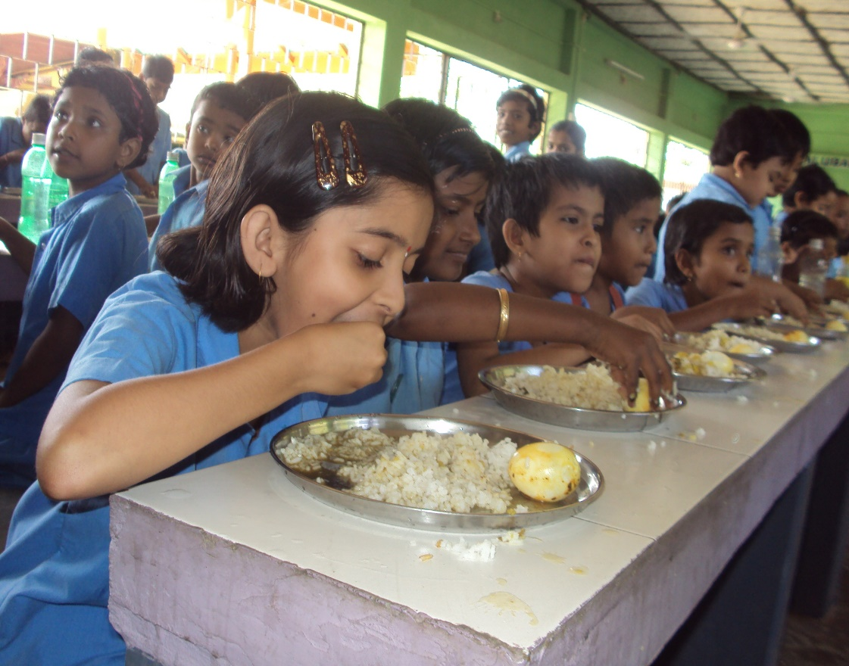
1.Provision of Dining hall:
Dining halls are being constructed with seating arrangement for taking the mid day meal in the school premises. At present, 288 nos. dining halls have been constructed using state’s own resources and more 48 nos. dining halls are in progress under MGNREGA.

Slide 16
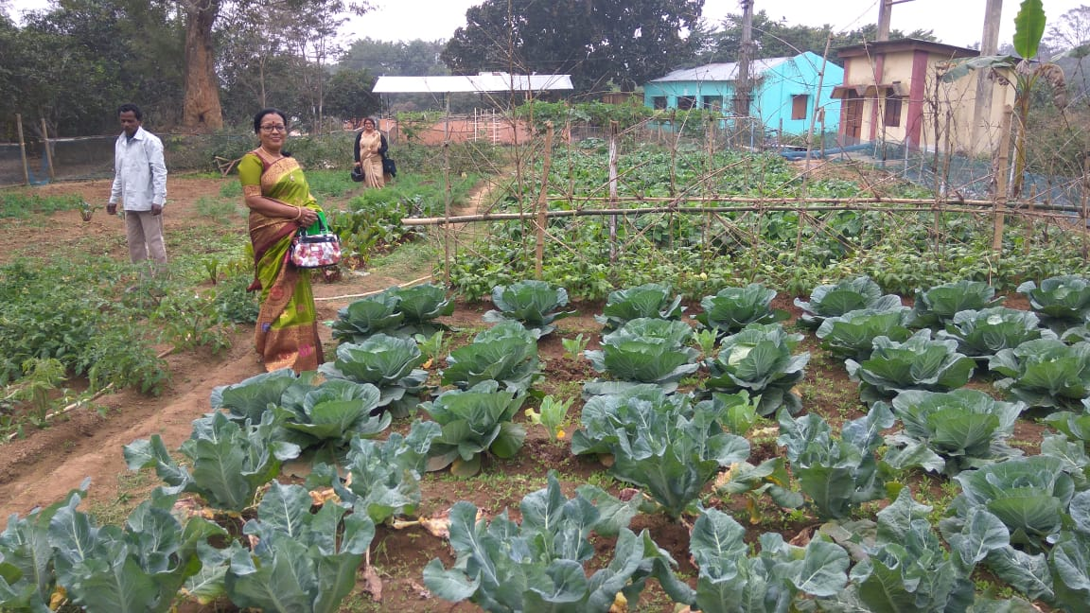
Kitchen gardens have been raised in 1639 schools with the objective of giving the children more nutritious & pesticide free food by using the vegetables like, cabbage, potato, tomato, brinjal, radish etc. grown in the kitchen gardens. As approved in the PAB 2019-20, Rs.5000/- will be provided to each school where kitchen garden have been raised.

Slide 17
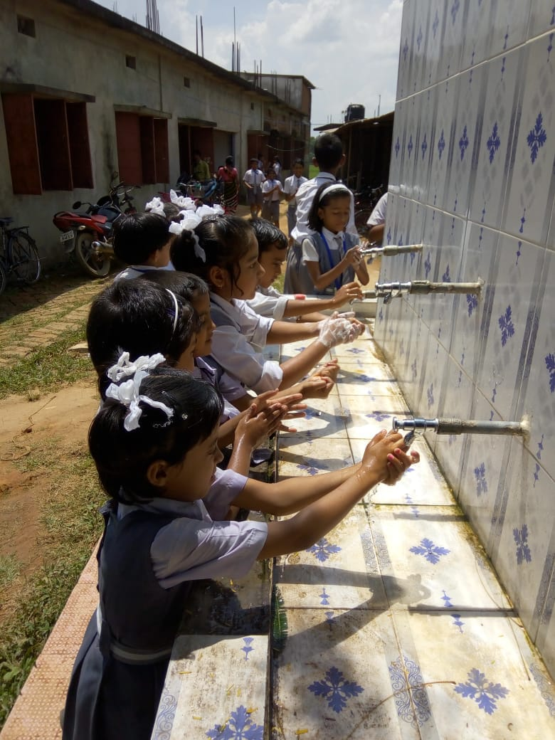
Hand wash activity has been implemented in all school units. The Department has introduced group hand washing system in 1562 nos. schools.

Slide 18
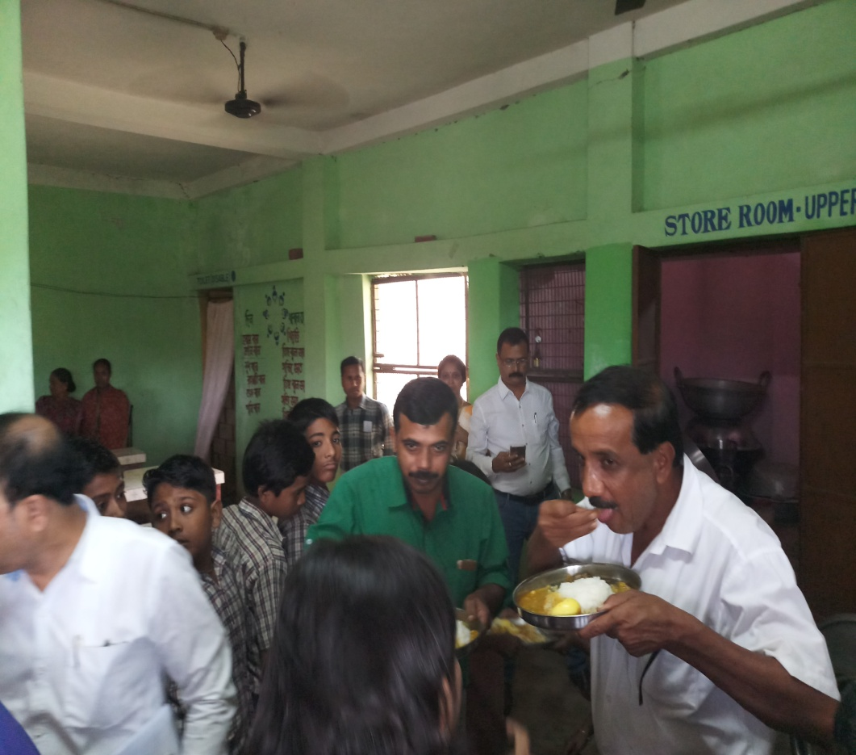
4. Practice of food tasting:
The practice of tasting of cooked food under MDM Programme are being implemented in all school units. Under the practice of tasting of cooked food every day cooked food (mid day meal) must be tasted by the assigned teacher first, secondly by one of the cook-cum-helpers and lastly by at least one mother / parent and they also write their comments in the specific food Tasting Register kept in every school before serving the Mid-Day-Meal to the students.

Slide 19
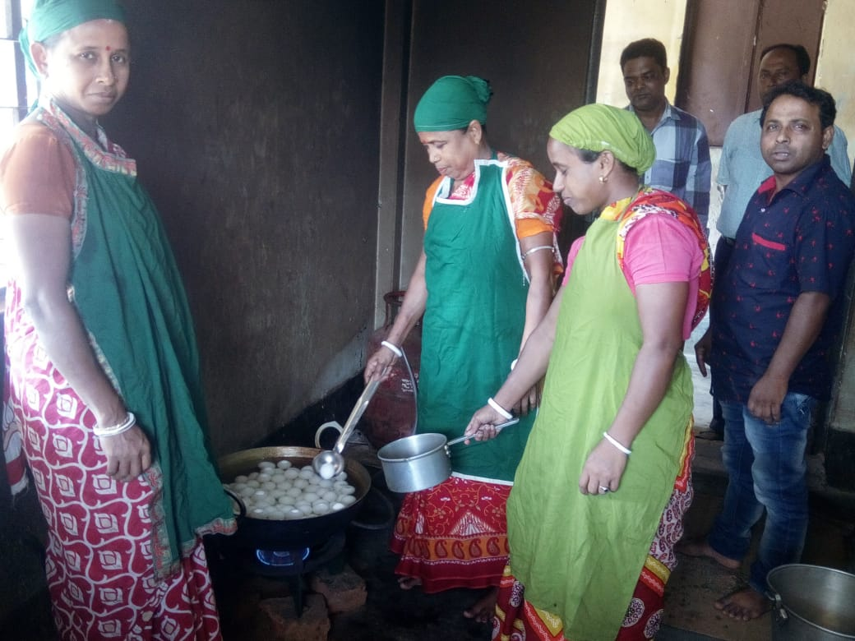
5. LPG based cooking system:
The Elementary Education has introduced the LPG based cooking system for preparing mid day meal at school in the state. Presently, 1711 schools are using LPG for preparation of Mid-day-Meal in school. The State Govt. has decided to provide the recurring refiling costs of cylinders @50 students per cylinder and also provided fund for installation of LPG based cooking system in more 1641 schools.

Slide 20
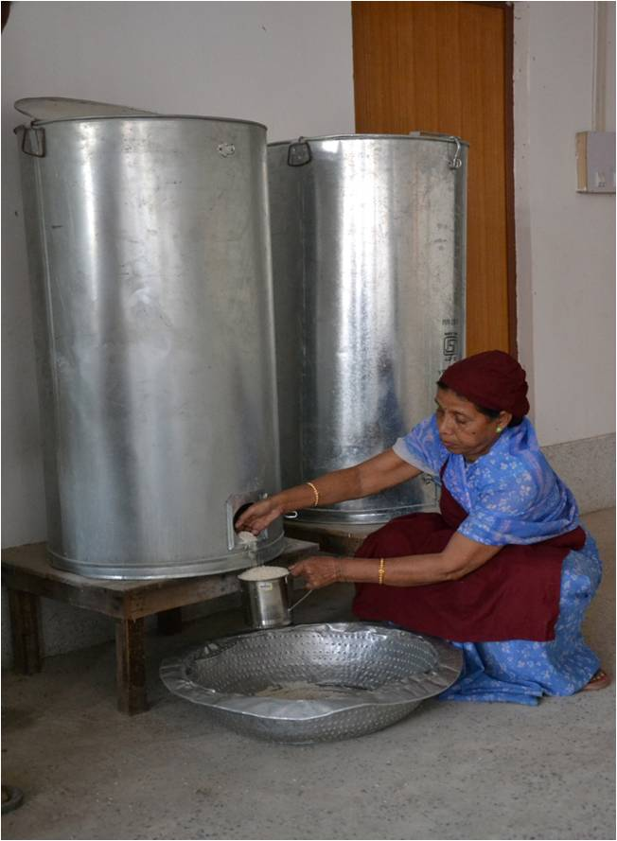
Safe storage bins scientifically designed with FIFO (First In First Out) system have been provided in all school units for storing the food grains in schools.

Slide 21
Proposed Budget for 2020-21

Slide 22
Proposed Annual Budget for the Year 2020-21 (In lakhs)
Sl. No | Component | Primary |  |  | Upper Primary |  |  | Total |  | Grand Total
 |  | CSS | State | Total | CSS | State | Total | CSS | State
1 | Cooking Cost | 2159.37 | 241.54 | 2400.91 | 1933.85 | 216.48 | 2164.75 | 4093.22 | 458.02 | 4551.23
2 | Cost of Food grains | 144.92 | 0.00 | 144.92 | 129.89 | 0.00 | 129.89 | 274.81 | 0.00 | 274.81
3 | Honorarium of CCH | 655.83 | 437.22 | 1093.05 | 336.69 | 224.46 | 561.15 | 992.52 | 661.68 | 1654.20
4 | Transportation Assistance | 139.61 | 0.00 | 139.61 | 125.12 | 0.00 | 125.12 | 264.73 | 0.00 | 264.73
Recurring Assistance |  | 3099.73 | 678.76 | 3778.49 | 2539.98 | 440.94 | 2980.91 | 5639.71 | 1119.70 | 6759.41
5 | MME | 83.69 | 0.00 | 83.69 | 68.19 | 0.00 | 68.19 | 151.88 | 0.00 | 151.88
Total Recurring Costs |  | 3183.43 | 678.76 | 3862.19 | 2593.73 | 440.94 | 3034.67 | 5777.16 | 1119.70 | 6896.86
Non-Recurring Assistance
6 | Repairing of Kitchen shed | 90.18 | 10.02 | 100.20 | 0.00 | 0.00 | 0.00 | 90.18 | 10.02 | 100.20
7 | Kitchen Devices | 142.02 | 15.78 | 157.80 | 0.00 | 0.00 | 0.00 | 142.02 | 15.78 | 157.80
8 | Additional fund for providing 2 eggs per week (68 days per children @RS.6/-) | 856.94 | 00 | 856.94 | 512.01 | 0.00 | 512.01 | 1368.95 | 0.00 | 1368.95
Grand Total |  | 4272.57 | 704.56 | 4977.13 | 3105.75 | 440.94 | 3546.68 | 7378.32 | 1145.50 | 8523.81

Slide 23
CSS: Rs.85.23 crore
State Share: Rs.11.46 crore
Total budget: Rs.73.78 crore

Slide 24
Proposal for food grains for the Year 2020-21
Stage | Enrolment | Proposed enrolment | Requirement of food grains (In MTs)
Primary | 2,66,326 | 2,10,035 | 4830.81
Upper Primary | 1,65,953 | 1,25,493 | 4329.51
Total | 4,32,279 | 3,35,528 | 9160.31

Slide 25
Proposal for additional fund & food grains during Summer Vacation for the Year 2020-21
Requirement of fund (in lakhs):
Stage | Enrolment | Number of days | Cooking Costs |  | TC/DC | Total
 |  |  | CSS | State
Primary | 266326 | 22 | 261.90 | 29.30 | 16.93 | 308.13
Upp. Primary | 165953 | 22 | 244.61 | 27.38 | 15.83 | 287.82
Total | 432279 | 22 | 506.51 | 56.68 | 32.76 | 595.96
Requirement of Food grains (in MTs):
Stage | Quantity of food grains
Primary | 585.92
Upper Primary | 547.64
Total | 1133.56

Slide 26
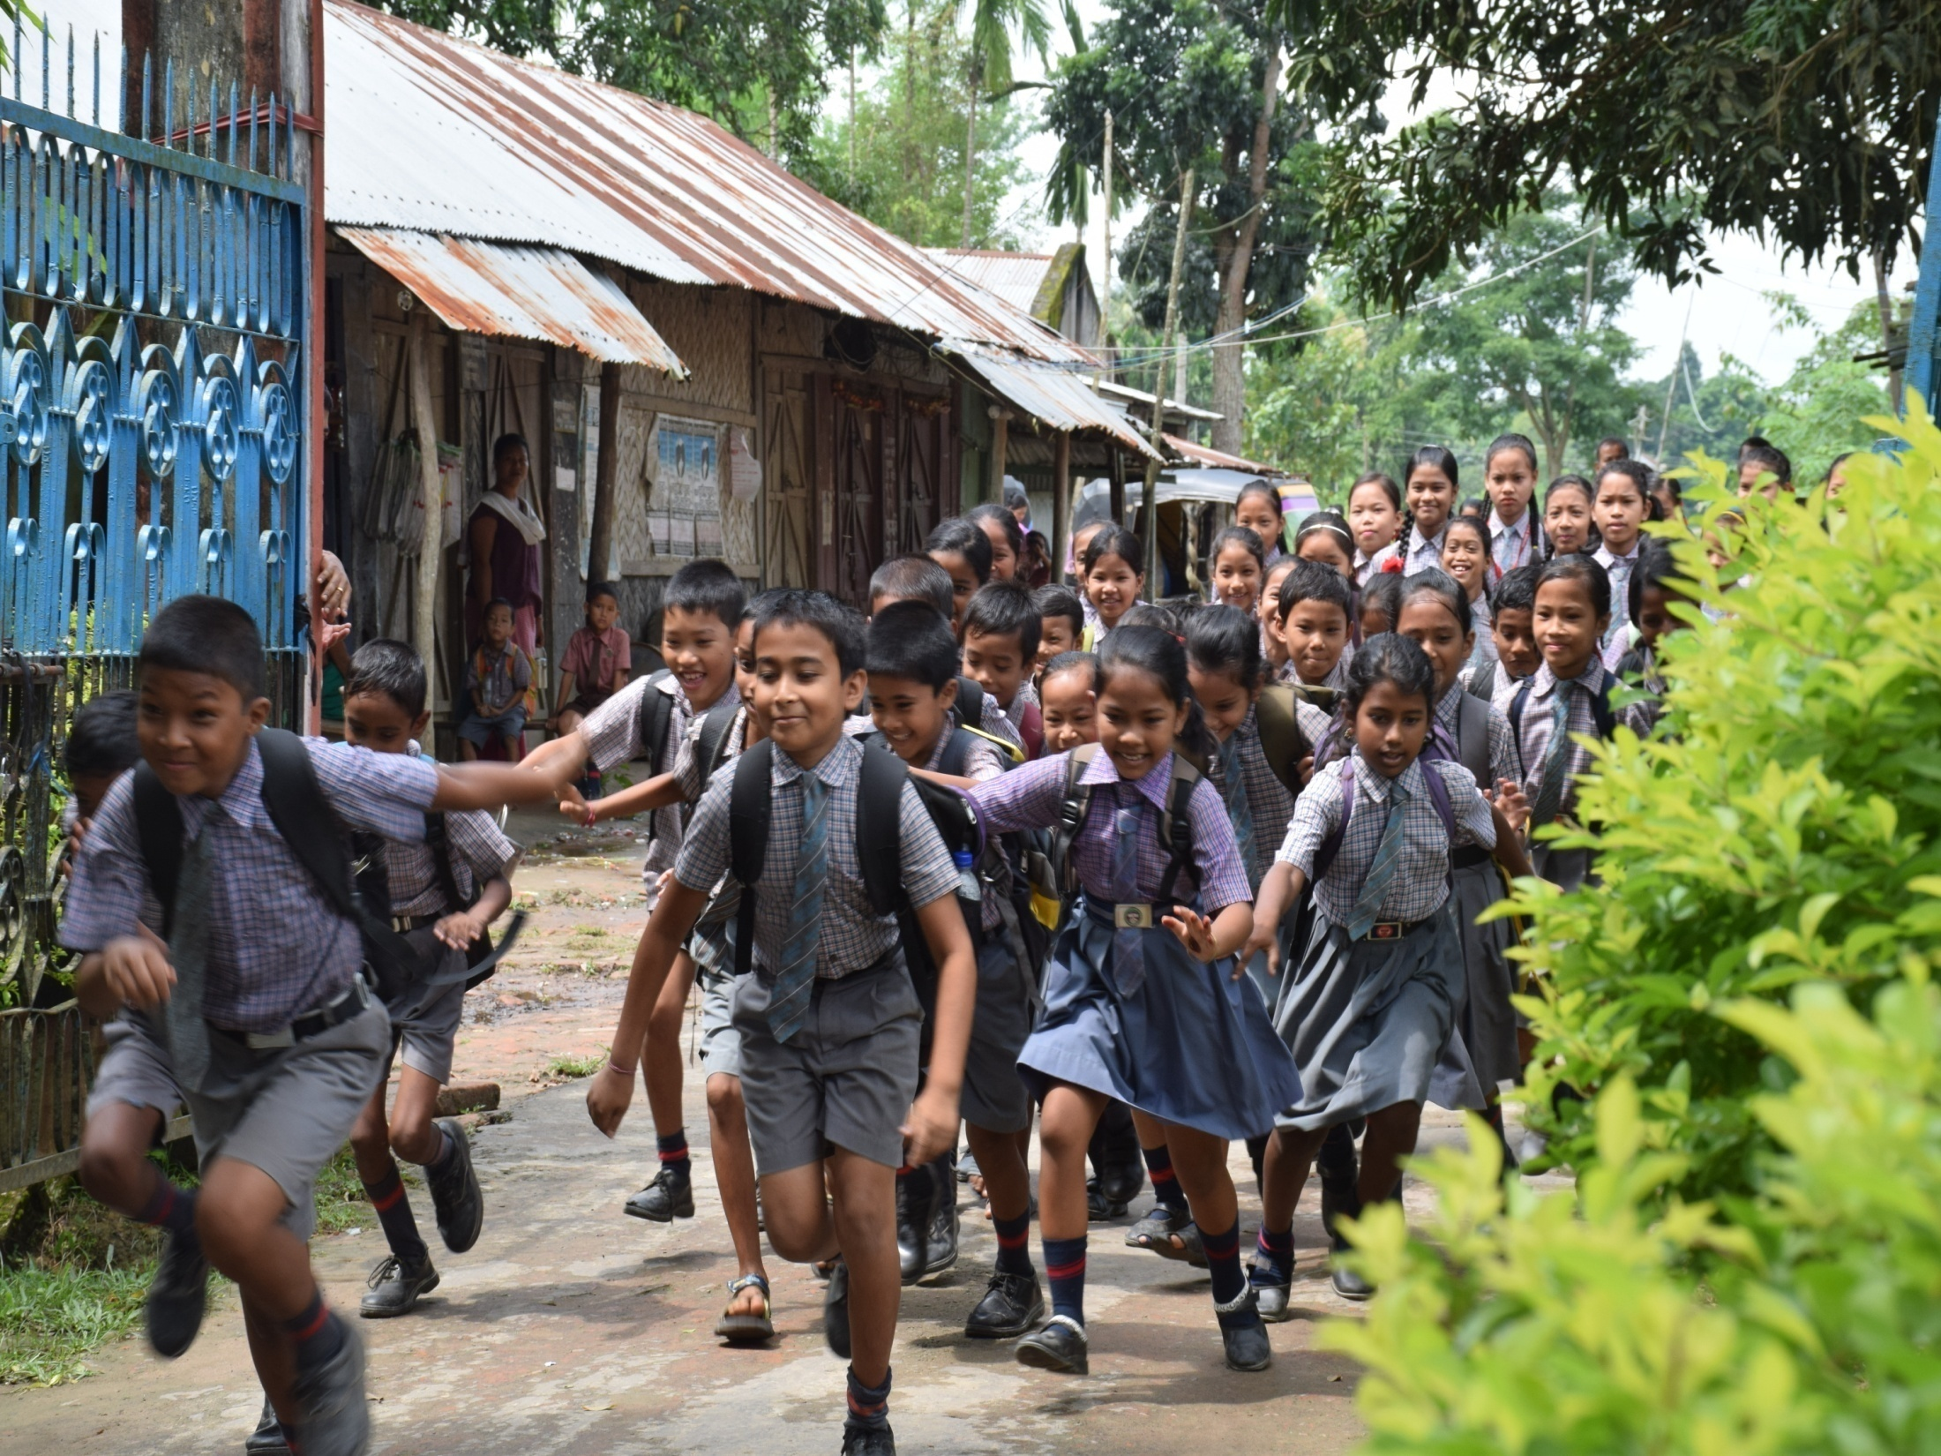
THANK YOU

